Slide 1
Instructions for Presentation on Past TES Results
Please use this slide deck from a TES training in Angola as a template for presenting your country’s TES results.
There are additional instructions in the notes for each slide.

Slide 2



Efficacy of Antimalarials in the Treatment of Uncomplicated Malaria in Three Provinces of Angola
MINISTÉRIO DA SAÚDE
DIRECÇÃO NACIONAL DE SAÚDE PÚBLICA
PROGRAMA NACIONAL DE CONTROLO DA MALÁRIA

Slide 3
Objectives
To measure the effectiveness of drugs against uncomplicated P. falciparum malaria:
AL - Coartem: Artemether-lumefantrine
ASAQ - Artesunate-amodiaquine
Estimating the prevalence of molecular markers of resistance

Slide 4
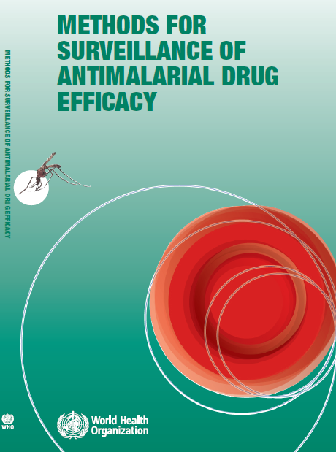
Study Design

Slide 5
Study Years and Sites
2013 | 2014 | 2015 | 2016 | 2017 | 2018 | 2019
2 | X | 3 | X | 3 | X | 4
Notes:
Use this slide to highlight which years a TES has been previously conducted in your country

Slide 6
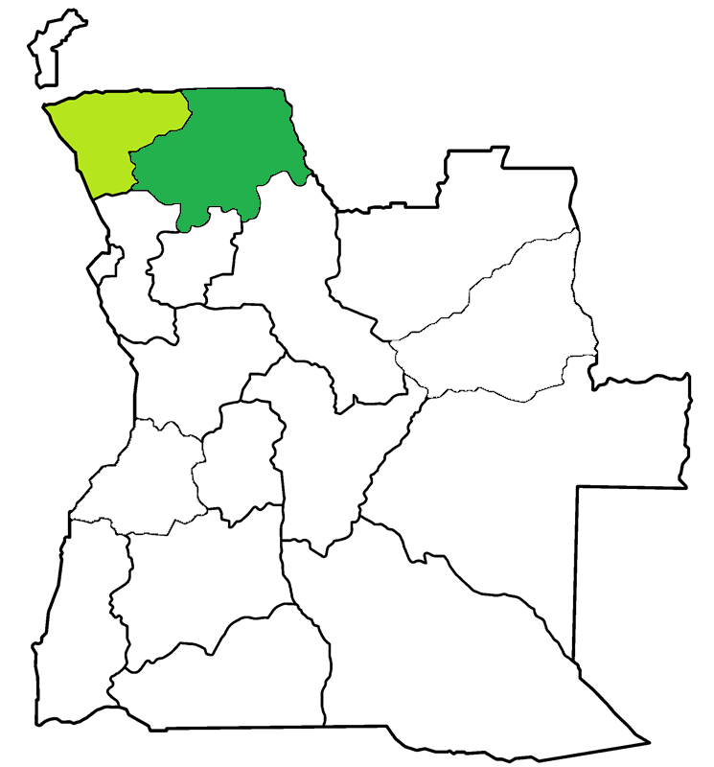
Feb-May 2013
AL
DP
Zaire
Uige
Notes:
Create a map for each past TES highlighting the regions in which the study was conducted and the time period

Slide 7
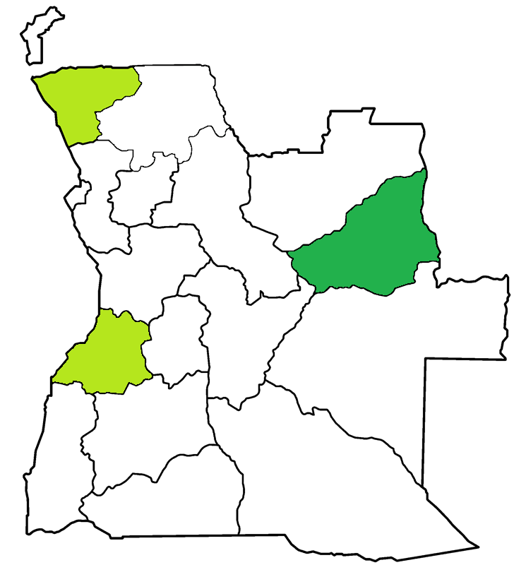
Feb-Jun 2015
AL
DP
Zaire
Lunda
South
ASAQ
DP
Benguela
AL
ASAQ
Notes:
Create a map for each past TES highlighting the regions in which the study was conducted and the time period

Slide 8
Mar-Jun 2017
AL
ASAQ
Zaire
Lunda
South
AL
DP
Benguela
ASAQ
DP
Notes:
Create a map for each past TES highlighting the regions in which the study was conducted and the time period

Slide 9
Participants: 2019 Past TES
Notes:
Use this graphic to summarize the number of participants in the most recent past TES in each site by treatment arm. The original table is in the training files folder in an excel document titled TES result figures (sheet 2.)
In green are participants who completed follow-up. In dark grey are those who were excluded at some point and in light grey are those who dropped out. The fewer dropouts the better!

Slide 10
Therapeutic Efficacy - AL
Notes:
Use this graphic to break down therapeutic efficacy and treatment outcomes for each study drug. The original table is in the training files folder in an excel document titled TES result figures (sheet 3.)
Participants are classified as having adequate clinical and parasitological response or therapeutic failure. Those with some treatment failure can be classified as early or late failure, which may be a reinfection or a recrudescence of the current infection. Participants who have an increase in parasitaemia from day 0 to day 2 of follow-up, who have not reduced their parasitaemia by 75% by day 3 of follow-up, had fever on day 3 or had severe signs of malaria between days 1 and 3 fall into the early treatment failure category. Participants who developed parasitaemia after day 3 were classified as having late treatment failure, only after testing the blood samples on filter paper can one tell whether this late failure represents a new infection or a recrudescence of the same infection.

Slide 11
Malaria Elimination Rate - AL
 | Zaire | Lunda Sul
 | n=94 | n=91
Day 2 | 97% (91–99) | 97% (91–99)
Day 3 | 100% (95–100) | 100% (95–100)
Numbers in parentheses represent the confidence interval
Notes:
Use this slide to illustrate the proportion of smear-negative samples on days 2 and 3

Slide 12
Therapeutic Efficacy – DP

Slide 13
Malaria Elimination Rate - DP
 | Bengula | Lunda Sul
 | n=85 | n=89
Day 2 | 98% (92–100) | 100% (95–100)
Day 3 | 100% (95–100) | 100% (95–100)
Numbers in parentheses represent confidence interval
Notes:
Proportion of smear-negative samples on days 2 and 3

Slide 14
Therapeutic Efficacy - ASAQ

Slide 15
Malaria Elimination Rate - ASAQ
 | Benguela | Zaire
 | n=91 | n=90
Day 2 | 100% (95–100) | 97% (91–99)
Day 3 | 100% (95–100) | 100% (95–100)
Numbers in parentheses represent confidence interval
Notes:
Proportion of smear-negative samples on days 2 and 3

Slide 16
Corrected Efficacy 2013-2017
 |  |  | Treatment
 |  |  | AL | ASAQ | DP
Province and Year | Zaire | 2013 | 89.6 |  | 100
 |  | 2015 | 88.1 |  | 98.8
 |  | 2017 | 95.5 | 93.3
 | Benguela | 2015 | 96.3 | 99.9
 |  | 2017 |  | 100 | 100
 | Lunda Sul | 2015 |  | 100 | 100
 |  | 2017 | 96.5 |  | 100
 | Uige | 2013 | 97.4 |  | 100
Notes:
Use this slide to compare efficacy of TES sites over time

Slide 17
Molecular Markers of Resistance Analysis
Markers of resistance to artemisinin derivatives
No failures had polymorphisms in marker K13
Lumefantrine resistance markers
100% of recrudescences and reinfections had polymorphisms in the mdr1 gene associated with resistance to lumefantrine

Slide 18
Summary
No evidence of resistance to artemisinin derivatives in Angola
Rapid elimination of the parasite
In 2017, high efficacy of DP, ASAQ, and AL
In 2015, corrected efficacy of 87% for AL in Zaire below the threshold of 90% set by WHO

